Slide 1
CSC 323 – Principles of Operating Systems
Instructor: Ms. Mamoona Tasadduq
Lecture# 10: Virtual Memory

Slide 2
Recap
Code needs to be in memory to execute, but entire program rarely used
  Error code, unusual routines, large data structures
Entire program code not needed at same time
Consider ability to execute partially-loaded program
  Program no longer constrained by limits of physical memory
  Each program takes less memory while running → more programs run concurrently
    Increased CPU utilization & throughput with no increase in response time or turnaround time
  Less I/O needed to load/swap programs into memory → each user program runs faster

Slide 3
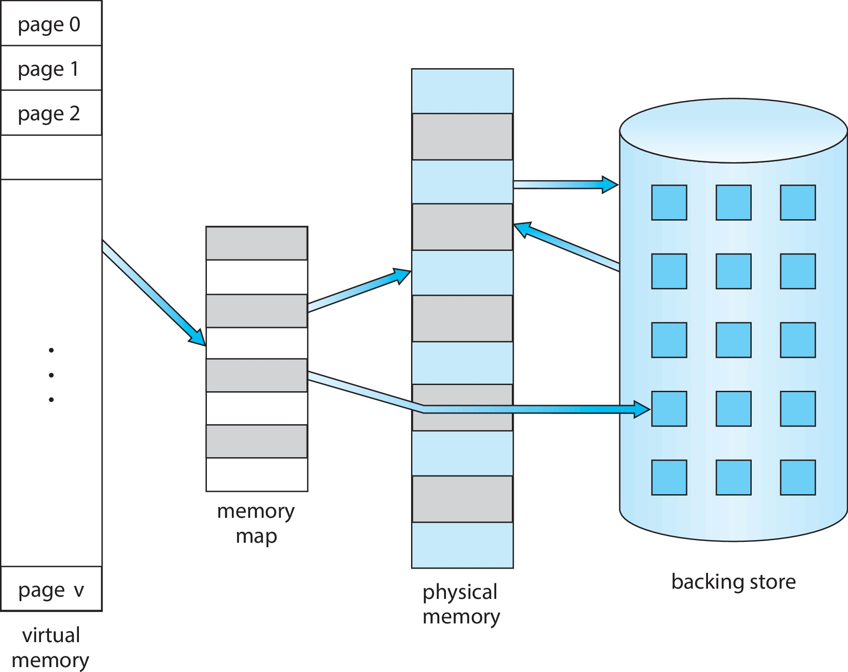
Virtual Memory
Separation of logical memory from physical memory
  Only part of the program needs to be in memory for execution
  Logical address space can therefore be much larger than physical address space
  Allows address spaces to be shared by several processes
  Allows for more efficient process creation
  More programs running concurrently
  Less I/O needed to load or swap processes

Slide 4
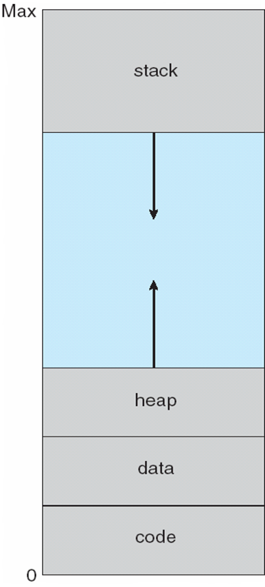
Virtual-Address Space
Virtual address space – logical view of how process is stored in memory
  Usually start at address 0, contiguous addresses until end of space
  Meanwhile, physical memory organized in frames
  MMU must map logical to physical addresses
Usually design logical address space for stack to start at Max logical address and grow “down” while heap grows “up” to maximize address space use. Unused address space between the two is hole, and no physical memory needed until heap or stack grows to a given new page.
Enables sparse address spaces with holes left for growth, dynamically linked libraries, etc.
System libraries shared via mapping into virtual address space
Shared memory by mapping pages read-write into virtual address space
Pages can be shared during fork(), speeding process creation

Slide 5
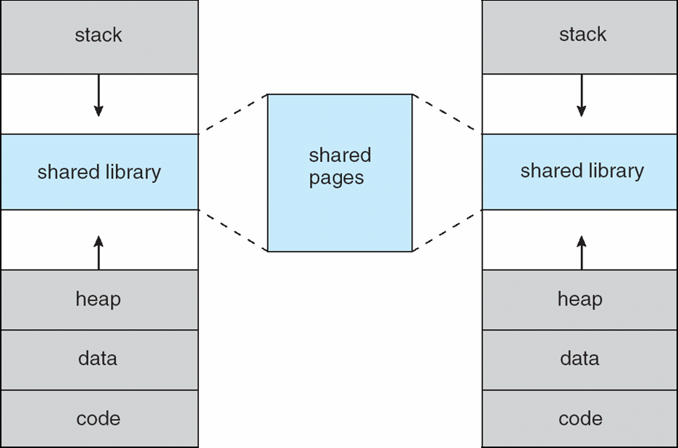
Shared Library Using Virtual Memory

Slide 6
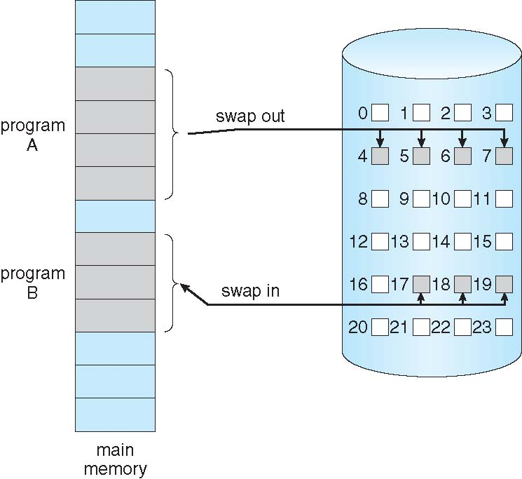
Demand Paging
Virtual memory can be implemented via demand paging
Bring entire process into memory at load time or bring a page into memory only when it is needed
  Less I/O needed, no unnecessary I/O
  Less memory needed
  Faster response
  More users
Similar to paging system with swapping. Page is needed → reference to it
  Invalid reference → abort
  Not-in-memory → (page fault) bring it to memory
Lazy swapper – never swaps a page into memory unless page will be needed
  Swapper that deals with pages is a pager

Slide 7
Demand Paging
With swapping, pager guesses which pages will be used before swapping out again and brings only those pages into memory
How to determine that set of pages?
  Need new MMU functionality to implement demand paging
No difference from simple paging if pages needed are already in memory
If page needed is not memory resident, need to detect and load the page into memory from storage
  Without changing program behavior
  Without programmer needing to change code

Slide 8
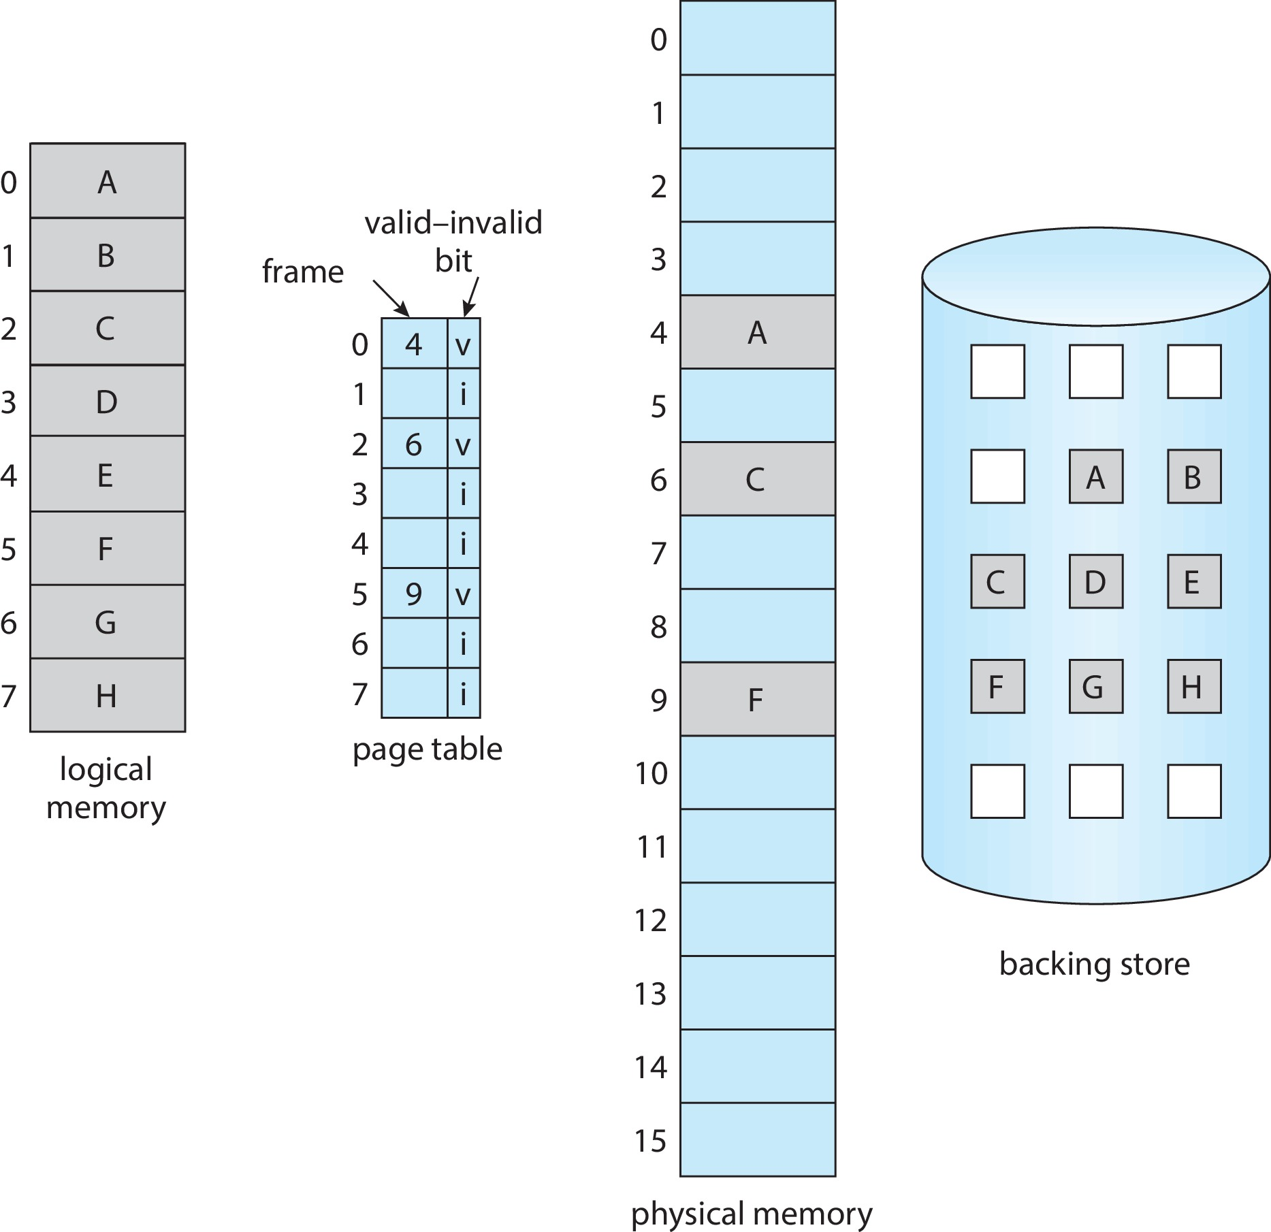
Valid-Invalid Bit
With each page table entry, a valid–invalid bit is associated
  (v → in-memory, i → not-in-memory)
Initially valid–invalid bit is set to i on all entries
During address translation, if valid–invalid bit in page table entry is i → page fault
Page Table When Some Pages Are Not in Main Memory

Slide 9
Handling a Page Fault
If there is a reference to a page, first reference to that page will trap to OS
  page fault
Upon reference to a page, the OS checks if it is an invalid reference or the page is just not in memory. If invalid reference, abort the process, otherwise just page it into the memory.
Find free frame or swap the page into frame via scheduled disk operation
Reset tables to indicate page now in memory (set validation bit = v) and restart the instruction that caused the page fault

Slide 10
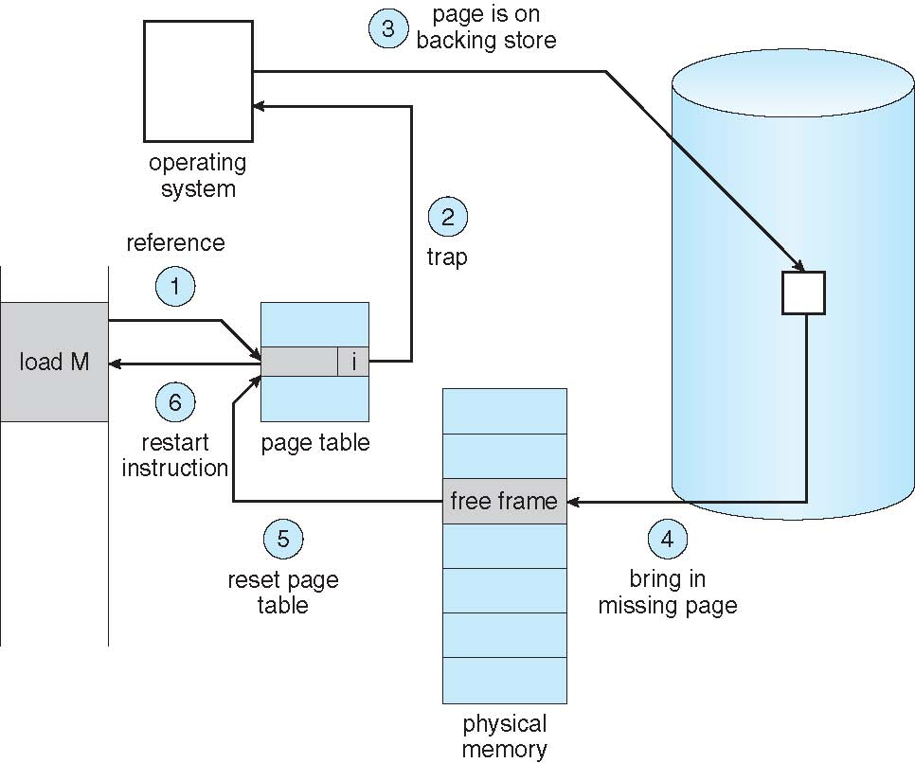
Handling a Page Fault

Slide 11
Aspects of Demand Paging
Extreme case – start process with no pages in memory
  OS sets instruction pointer to first instruction of process, which is non-memory-resident (Page fault). Page is brought into the memory
  Process continue to execute, faulting as necessary until every page that it needs is in memory after which it can execute with no more faults.
  Pure demand paging
Actually, a given instruction could access multiple pages (multiple page faults)
  Consider fetch and decode of instruction which adds 2 numbers from memory and stores result back to memory
  Pain decreased because of locality of reference
Hardware support needed for demand paging
  Page table with valid / invalid bit
  Secondary memory (swap device with swap space)
  Instruction restart

Slide 12
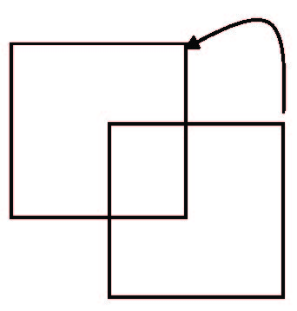
Instruction Restart
Consider an instruction that could access several different locations and source, and destination overlap.
  Block move
The problem can be solved in two different ways.
  The microcode computes and attempt to access both ends of both blocks. If page fault is going to occur. It will be identified at this step before anything is modified.
  Use the temporary registers to hold the values of overwritten locations
If page fault, all the old values are written back into the memory before the trap occur. Restore the memory to its state before instruction was started so that the instruction can be repeated.

Slide 13
Free-Frame List
When a page fault occurs, the operating system must bring the desired page from secondary storage into main memory.
Most operating systems maintain a free-frame list – a pool of free frames for satisfying such requests.
Operating system typically allocate free frames using a technique known as zero-fill-on-demand – the content of the frames zeroed-out before being allocated.
When a system starts up, all available memory is placed on the free-frame list.

Slide 14
Stages in Demand Paging – Worst Case
Trap to the operating system
Save the user registers and process state
Determine that the interrupt was a page fault
Check that page reference was legal and determine location of the page on the disk
Issue a read from the disk to a free frame:
  Wait in a queue for this device until the read request is serviced
  Wait for the device seek and/or latency time
  Begin the transfer of the page to a free frame
While waiting, allocate the CPU to some other user
Receive an interrupt from the disk I/O subsystem (I/O completed)
Save the registers and process state for the other user
Determine that the interrupt was from the disk
Correct the page table and other tables to show that desired page is now in memory
Wait for the CPU to be allocated to this process again
Restore the user registers, process state, and new page table, and then resume the interrupted instruction

Slide 15
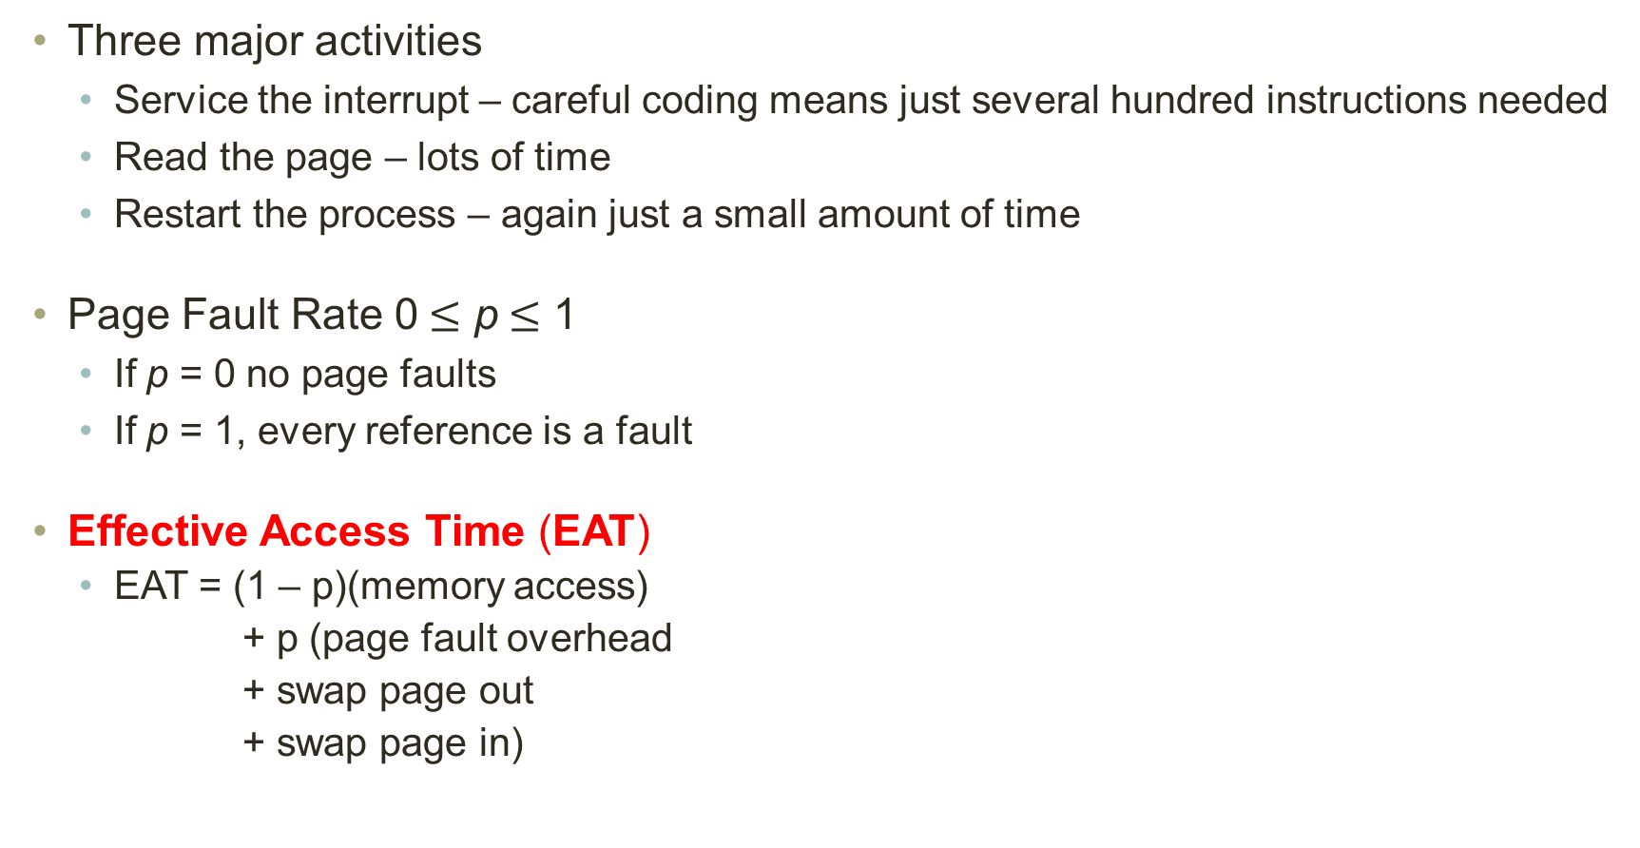
Performance of Demand Paging
Three major activities
  Service the interrupt – careful coding means just several hundred instructions needed
  Read the page – lots of time
  Restart the process – again just a small amount of time
Page Fault Rate 0$≤$ p$≤$ 1
  If p = 0 no page faults
  If p = 1, every reference is a fault
Effective Access Time (EAT)
  EAT = (1 – p)(memory access)
  + p (page fault overhead
  + swap page out
  + swap page in)

Slide 16
Demand Paging Example
Memory access time = 200 nanoseconds
Average page-fault service time = 8 milliseconds
EAT = (1 – p) (200) + (p)(8 milliseconds)
= (1 – p) (200) + (p)(8,000,000)
= 200 + (p)(7,999,800)
If one access out of 1,000 causes a page fault, then EAT = 8.2 microseconds.
This is a slowdown by a factor of 40!!
If want performance degradation < 10 percent
  220 > 200 + 7,999,800 x p
  20 > 7,999,800 x p
  p < .0000025
  < one page fault in every 400,000 memory accesses

Slide 17
Demand Paging Optimizations
Swap space I/O faster than file system I/O even if on the same device
  Swap allocated in larger chunks; less management needed than file system
Copy entire process image to swap space at process load time
  Then page in and out of swap space (used in older BSD Unix)
Demand page in from program binary on disk, but discard rather than paging out when freeing frame
  Used in Solaris and current BSD
  Still need to write to swap space
    Pages not associated with a file (like stack and heap) – anonymous memory
    Pages modified in memory but not yet written back to the file system
Mobile systems
  Typically, don’t support swapping
  Instead, demand page from file system and reclaim read-only pages (such as code)

Slide 18
Copy-on-Write
Copy-on-Write (COW) allows both parent and child processes to initially share the same pages in memory
  If either process modifies a shared page, only then is the page copied
COW allows more efficient process creation as only modified pages are copied
In general, free pages are allocated from a pool of zero-fill-on-demand pages
  Pool should always have free frames for fast demand page execution
    Don’t want to have to free a frame as well as other processing on page fault
  Why zero-out a page before allocating it?
vfork() variation on fork() system call has parent suspend and child using copy-on-write address space of parent
  Designed to have child call exec()
  Very efficient

Slide 19
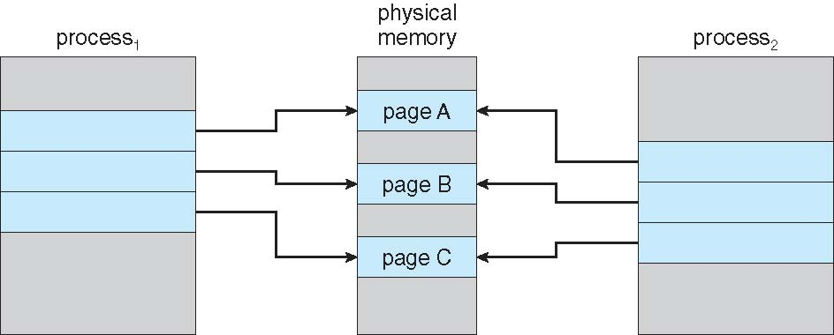
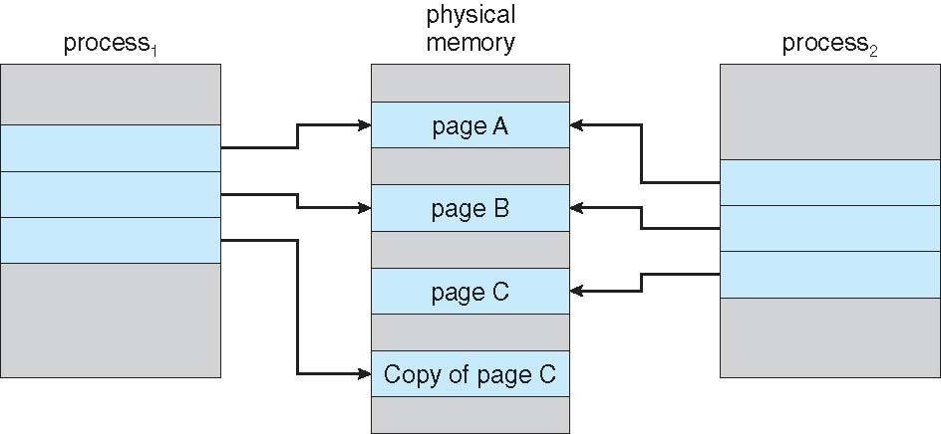
Copy-on-Write
Before Process 1 Modifies Page C
After Process 1 Modifies Page C

Slide 20
Demand Paging
What Happens if There is no Free Frame on the free-frame list?
Used up by process pages
Also in demand from the kernel, I/O buffers, etc
How much to allocate to each?
Page replacement – find some page in memory, but not really in use, page it out
  Algorithm – terminate? swap out? replace the page?
  Performance – want an algorithm which will result in minimum number of page faults
Same page may be brought into memory several times

Slide 21
Page Replacement
Prevent over-allocation of memory by modifying page-fault service routine to include page replacement
Use modify (dirty) bit to reduce overhead of page transfers – only modified pages are written to disk
Page replacement completes separation between logical memory and physical memory – large virtual memory can be provided on a smaller physical memory

Slide 22
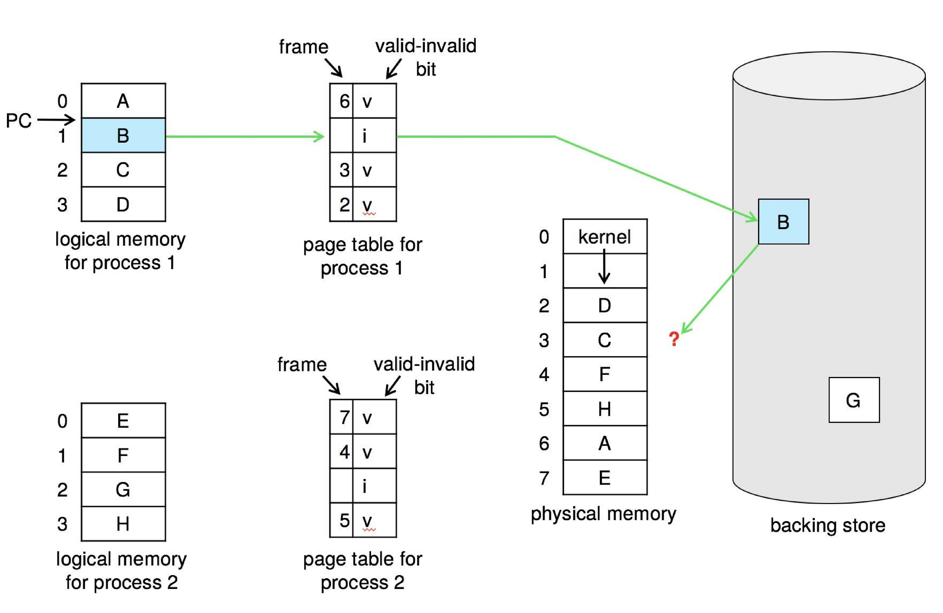
Need For Page Replacement

Slide 23
Basic Page Replacement
Find the location of the desired page on disk
Find a free frame
  If there is a free frame, use it
  If there is no free frame, use a page replacement algorithm to select a victim frame
  Write the victim frame to the disk if dirty
Bring desired page into (newly) free frame; update the page and frame tables
Continue the process by restarting the instruction that caused the trap
Note: Now there are two page-transfers for a page fault – increasing EAT

Slide 24
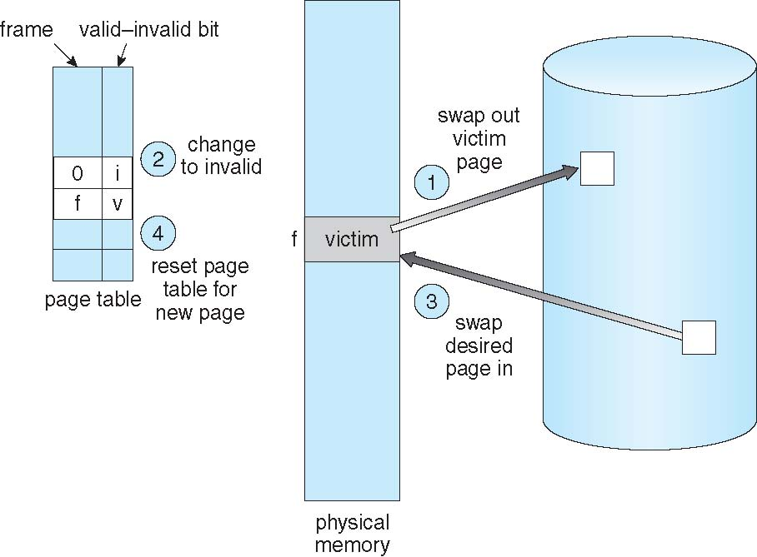
Page Replacement

Slide 25
Page and Frame Replacement Algorithms
Frame-allocation algorithm determines how many frames to give each process and which frames to replace
Page-allocation algorithm – Want lowest page-fault rate on both first access and re-access
Evaluate algorithm by running it on a particular string of memory references (reference string) and computing the number of page faults on that string
  String is just page numbers, not full addresses
  Repeated access to the same page does not cause a page fault
  Results depend on number of frames available
In all our further examples, the reference string will be as follow :
7,0,1,2,0,3,0,4,2,3,0,3,0,3,2,1,2,0,1,7,0,1

Slide 26
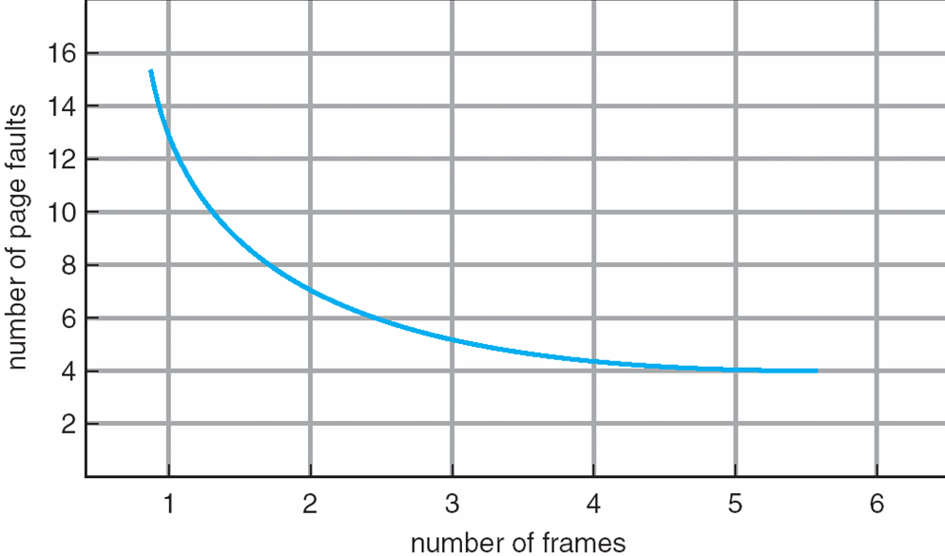
Number of Frames vs. Page Faults

Slide 27
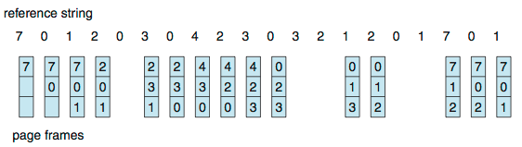
First-In-First-Out (FIFO) Algorithm
Reference string: 7,0,1,2,0,3,0,4,2,3,0,3,0,3,2,1,2,0,1,7,0,1
3 frames (3 pages can be in memory at a time per process)
Can vary by reference string: consider 1,2,3,4,1,2,5,1,2,3,4,5
  Adding more frames can cause more page faults!
    Belady’s Anomaly
How to track ages of pages?
  Just use a FIFO queue
Page Hit = 5
Page Miss = Page Fault = 15
Page Fault Ratio = 75%

Slide 28
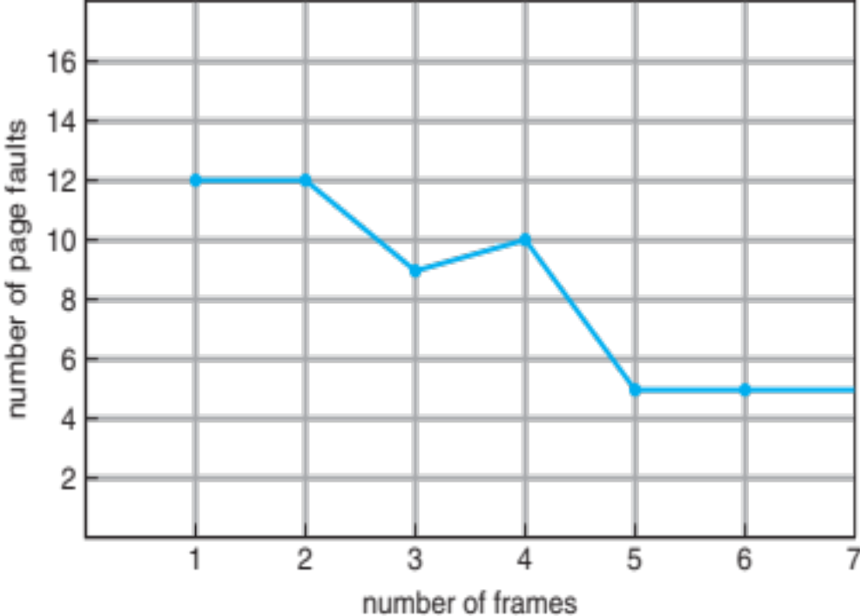
FIFO Illustrating Belady’s Anomaly

Slide 29
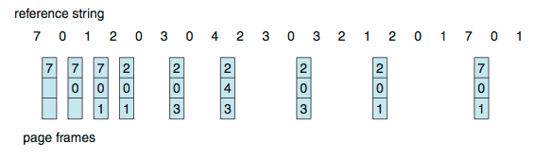
Optimal Algorithm
Reference string: 7,0,1,2,0,3,0,4,2,3,0,3,0,3,2,1,2,0,1,7,0,1
Replace page that will not be used for longest duration
9 is optimal for the example
How do you know this?
  Can’t read the future
Used for measuring how well your algorithm performs
Page Hit = 11
Page Miss = Page Fault = 9
Page Fault Ratio = 45%

Slide 30
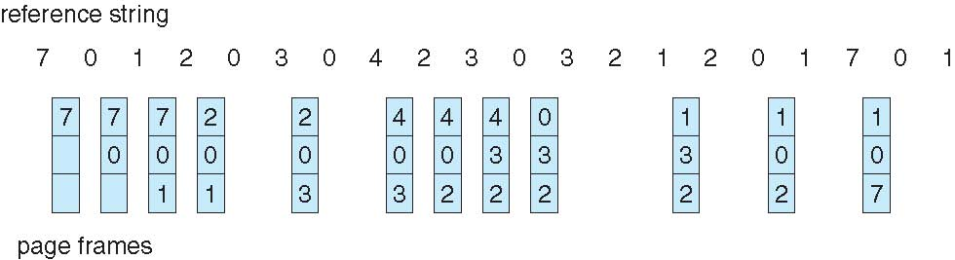
Least Recently Used (LRU) Algorithm
Reference string: 7,0,1,2,0,3,0,4,2,3,0,3,0,3,2,1,2,0,1,7,0,1
Use past knowledge rather than future
Replace page that has not been used in the most amount of time
Associate time of last use with each page
12 faults – better than FIFO but worse than OPT
Generally good algorithm and frequently used
But how to implement?
Page Hit = 8
Page Miss = Page Fault = 12
Page Fault Ratio = 60%

Slide 31
Least Recently Used (LRU) Algorithm
Counter implementation
  Every page entry has a counter; every time page is referenced through this entry, copy the clock into the counter
  When a page needs to be changed, look at the counters to find smallest value
    Search through table needed
Stack implementation
  Keep a stack of page numbers in a double link form:
  Page referenced:
    move it to the top
    requires 6 pointers to be changed
  But each update more expensive
  No search for replacement

Slide 32
Global vs. Local Allocation
Global replacement – process selects a replacement frame from the set of all frames; one process can take a frame from another
  But then process execution time can vary greatly
  But greater throughput so more common
Local replacement – each process selects from only its own set of allocated frames
  More consistent per-process performance
  But possibly underutilized memory

Slide 33
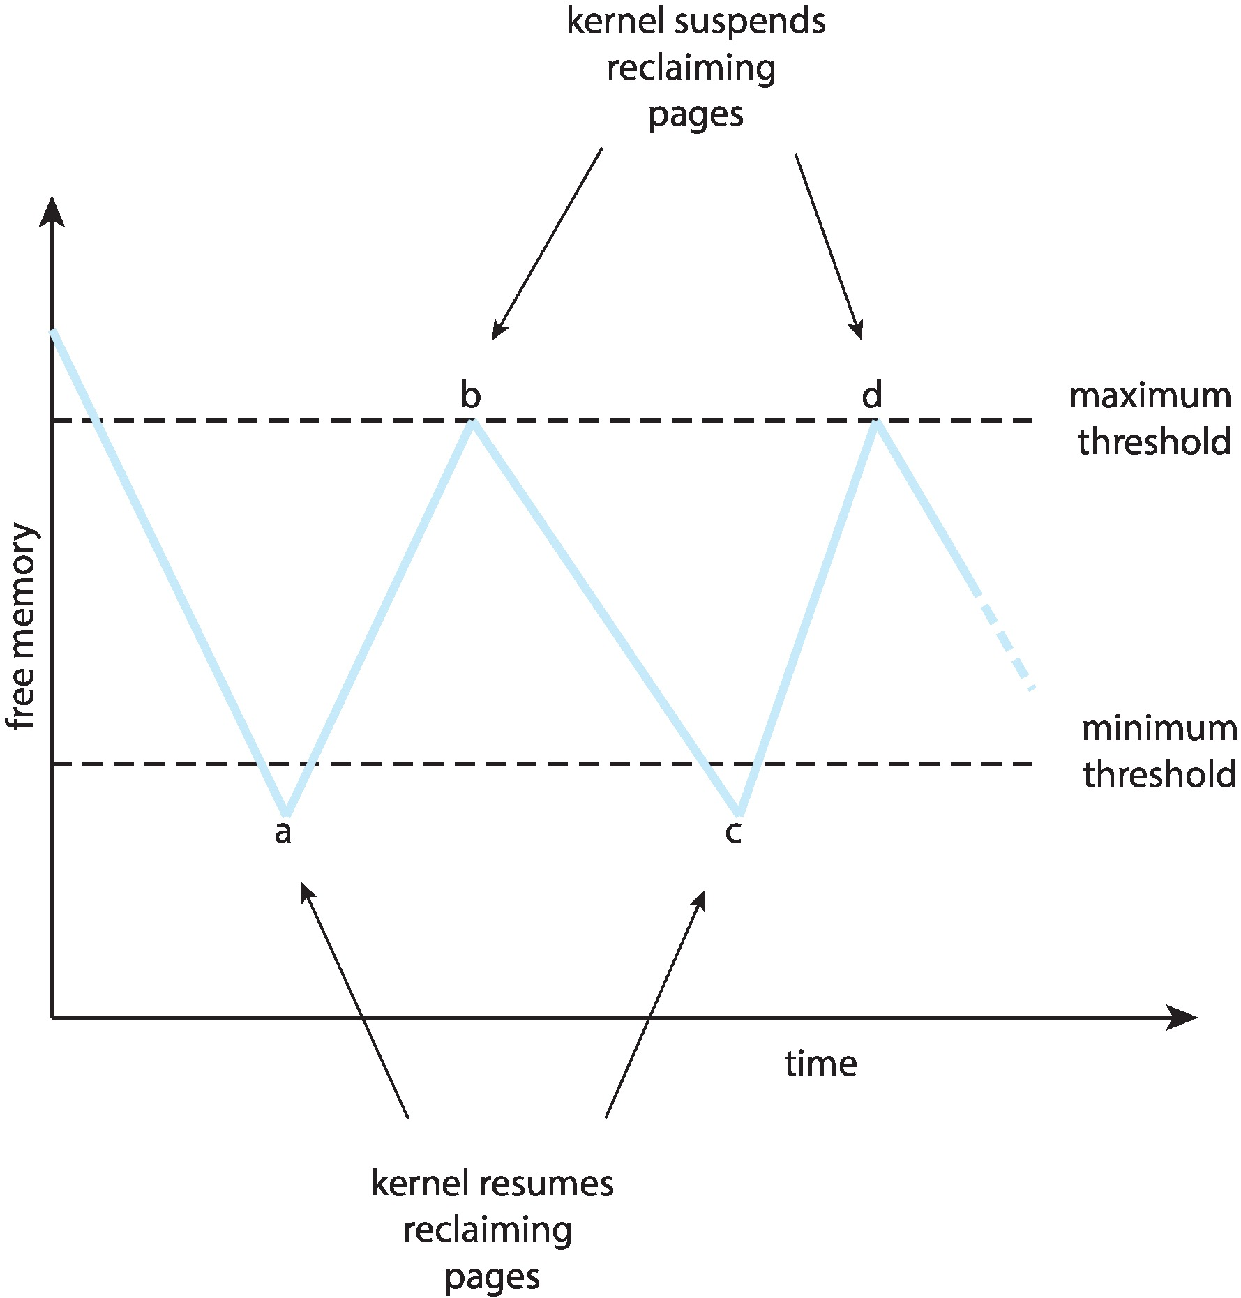
Reclaiming Pages
A strategy to implement global page-replacement policy
All memory requests are satisfied from the free-frame list, rather than waiting for the list to drop to zero before we begin selecting pages for replacement,
Page replacement is triggered when the list falls below a certain threshold.
This strategy attempts to ensure there is always sufficient free memory to satisfy new requests.

Slide 34
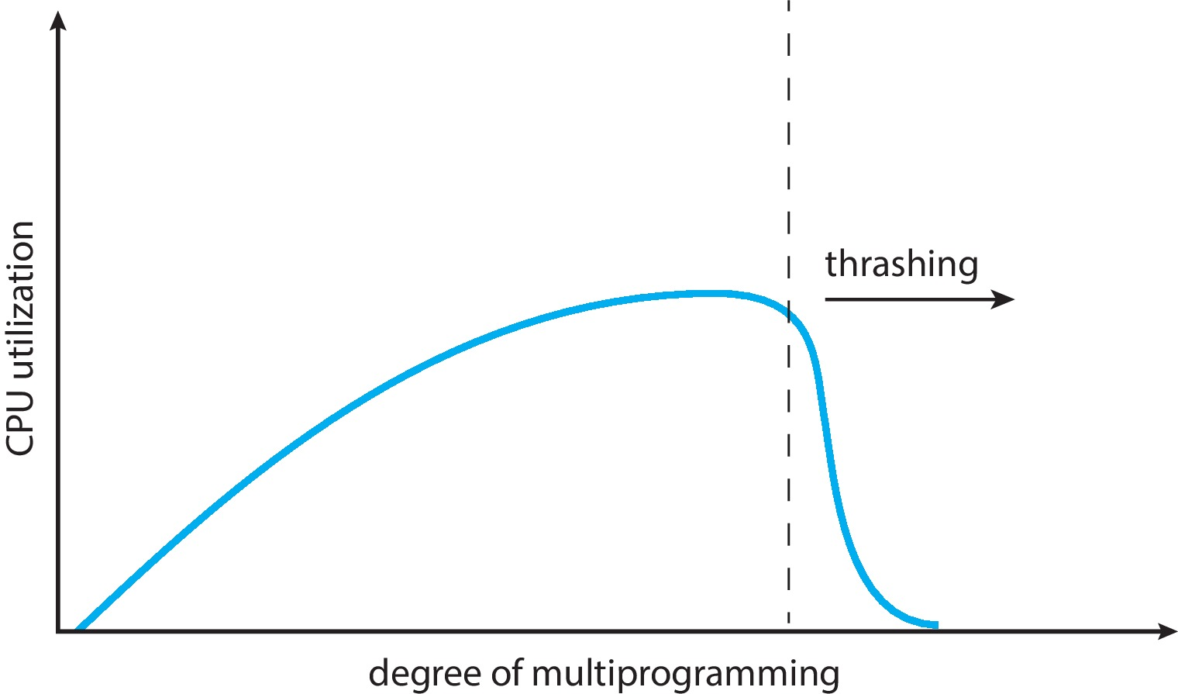
Thrashing
If a process does not have “enough” pages, the page-fault rate is very high
  Page fault to get page
  Replace existing frame
  But quickly need replaced frame back
  This leads to:
    Low CPU utilization
    Operating system thinking that it needs to increase the degree of multiprogramming
    Another process added to the system
Thrashing – A process is busy swapping pages in and out rather than executing

Slide 35
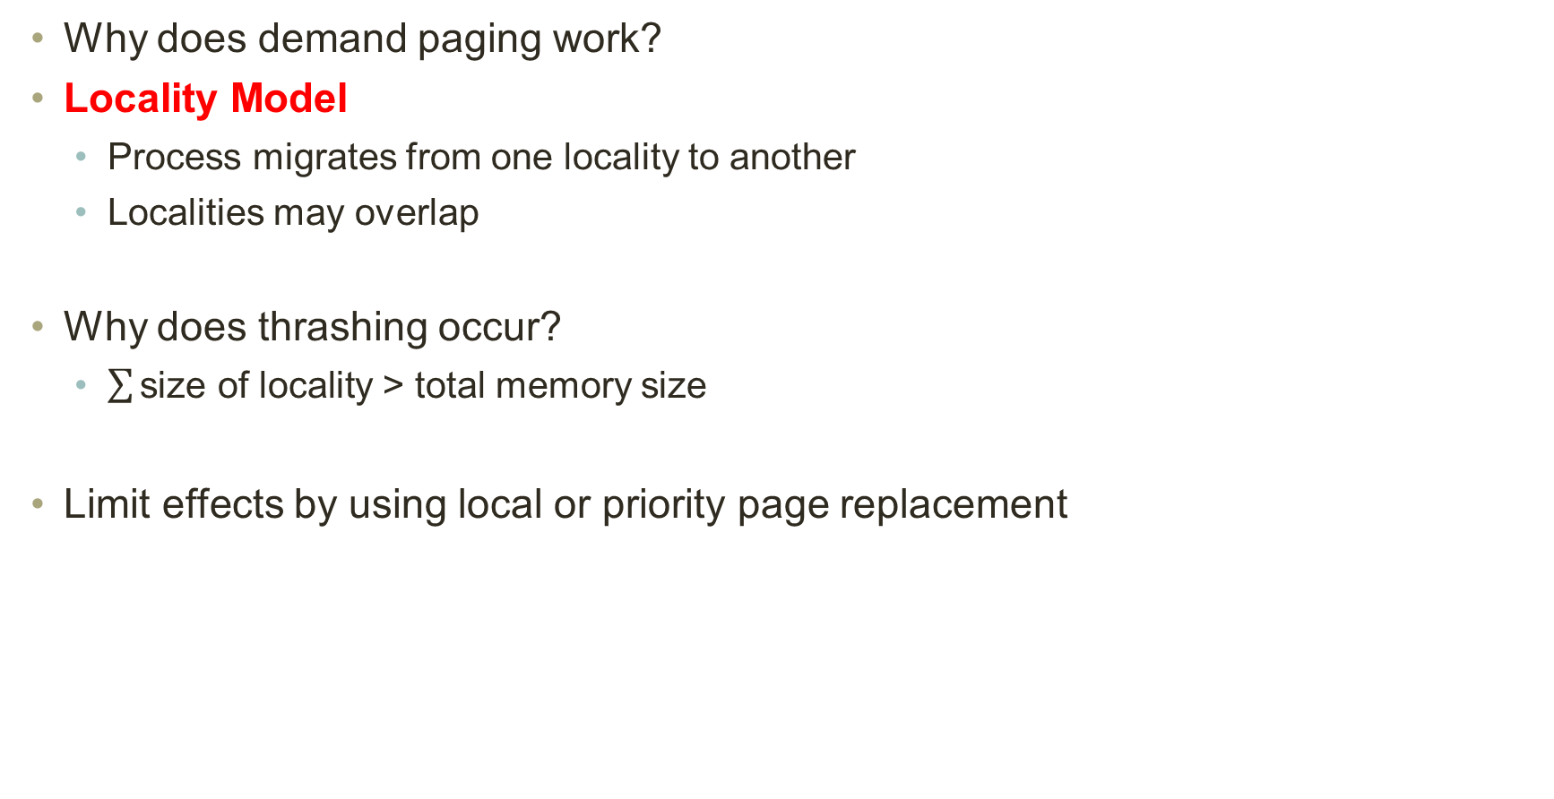
Demand Paging and Thrashing
Why does demand paging work?
Locality Model
  Process migrates from one locality to another
  Localities may overlap
Why does thrashing occur?
  $\sum{\text{size} \text{of} \text{locality}}$ > total memory size
Limit effects by using local or priority page replacement

Slide 36
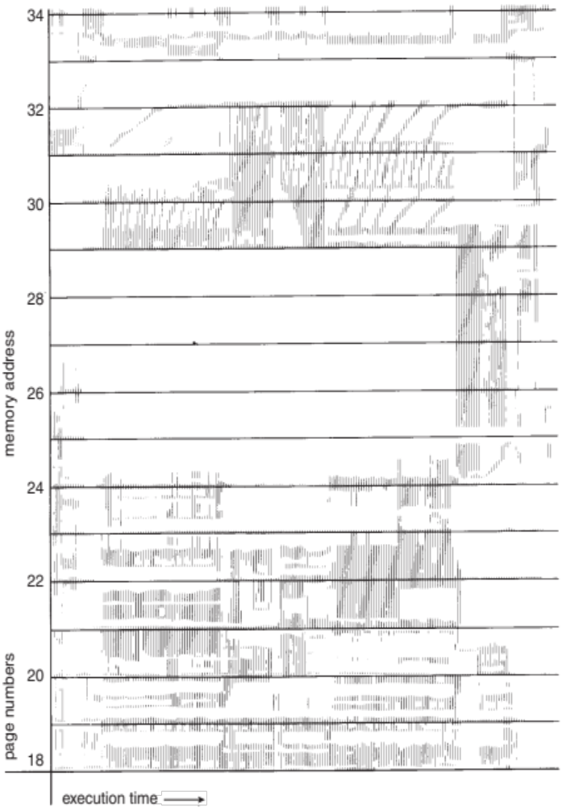
Locality In A Memory-Reference Pattern

Slide 37
Locality Model
To prevent thrashing, we must provide a process as many frames as it needs. But how do we know how many frames it "needs"? There are several techniques.
  The working-set strategy starts by looking at how many frames a process is actually using. This approach defines the locality model of process execution.
Locality model states that, as process executes, it moves from locality to locality.
A locality is a set of pages that are actively used together. A program is generally composed of several different localities, which may overlap.

Slide 38
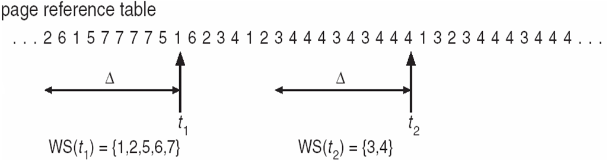
Working-Set Model
The working set model is based on the assumption of locality.
Δ ≡ working-set window ≡ a fixed # of page references (e.g. 10,000 instructions).
Idea is to examine the most recent Δ page references. The set of pages in the most recent Δ page references is the working set.
If a page is in active use, it will be in the working set. Otherwise, it will drop from the working set Δ time units after its last reference. Thus, the working set is an approximation of the program's locality.

Slide 39
Working-Set Model
WSSi (working set size of Process Pi) = total number of pages referenced in the most recent Δ (varies in time)
  If Δ is too small, it will not encompass entire locality
  If Δ is too large, it will encompass several localities
  If Δ= ∞⇒ it will encompass entire program
D= ΣWSS_{i} ≡ total demand frames
  Approximation of locality
If D > m (total number of available frames)⇒Thrashing will occur. In this case, suspend or swap out one of the processes

Slide 40
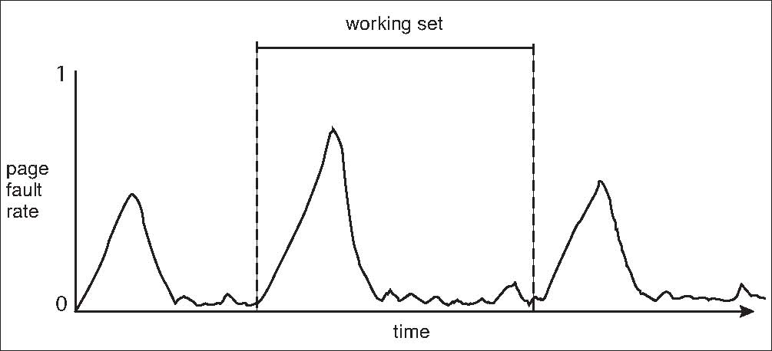
Working Sets and Page Fault Rates
Direct relationship between working set of a process and its page-fault rate
Working set changes over time
Peaks and valleys over time

Slide 41
Other Considerations
The selection of page replacement algorithm and allocation policy are the major decisions that we make for a paging system. There are many other considerations as well.
Prepaging
Program structure
Page size

Slide 42
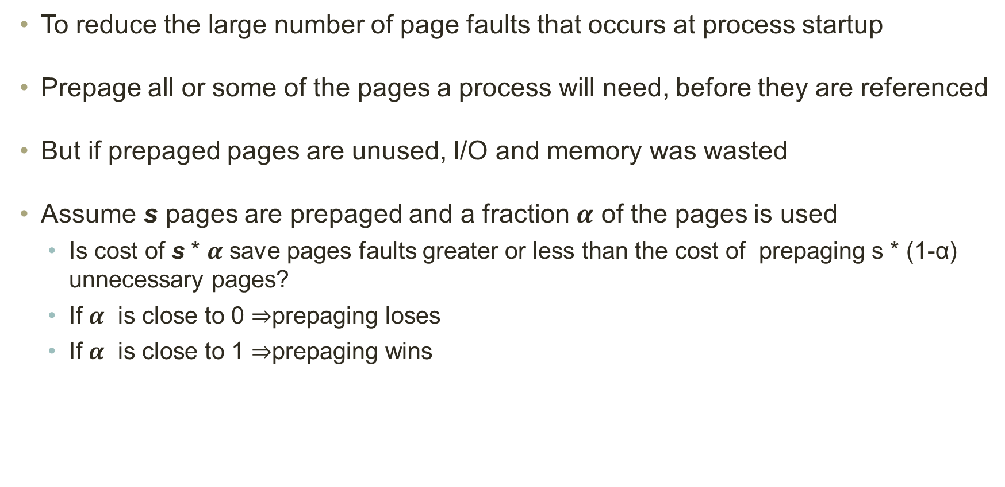
Prepaging
To reduce the large number of page faults that occurs at process startup
Prepage all or some of the pages a process will need, before they are referenced
But if prepaged pages are unused, I/O and memory was wasted
Assume s pages are prepaged and a fraction $α$ of the pages is used
  Is cost of s * $α$ save pages faults greater or less than the cost of prepaging s * (1-α) unnecessary pages?
  If $α$ is close to 0 ⇒prepaging loses
  If $α$ is close to 1 ⇒prepaging wins

Slide 43
Program Structure
Program structure
  Int data[128][128];
  Each row is stored in one page
  Program 1
for (j = 0; j <128; j++)
for (i = 0; i < 128; i++)
data[i][j] = 0;
  Program 2
for (i = 0; i <128; i++)
for (j = 0; j < 128; j++)
data[i][j] = 0;
128 x 128 = 16,384 page faults
128 page faults

Slide 44
Page Size
Page size selection must take into consideration:
Fragmentation:
  The bigger the page size the more internal fragmentation it will have. On average each segment will have half a page of internal fragmentation. So, if we have a page of 2K then 1K will be wasted in each segment. This means that from fragmentation point of view smaller page is better.
Page Table Size:
  Page table contains frame numbers for each page. If there are more pages, then there will be more entries meaning page table will be big. If we increase page size, then there will be lesser entries in the page table resulting in smaller page table. A smaller page table will require less memory. So, from page table point of view bigger page size is desirable.

Slide 45
Page Size
Page size selection must take into consideration:
I/O Overhead:
  In I/O operation to hard disk the biggest penalty is the seek time. Once the correct sector is reached then reading or writing data is not that time consuming. Reading or writing 2K fractionally consumes more time than 1K. This means that from an I/O overhead bigger page size is better.
Locality:
  Locality is the set of logical addresses that a process generates in some delta time. It changes as the process continues its execution. Smaller page size can give a fine grain control over the locality by bringing into RAM only those areas of address space that are needed. A bigger page will bring in more than what is needed resulting in wasted space. So, from locality consideration a smaller page is better.

